Slide 1
Fundamentals of Computer Science
Researching and Academic Integrity

Slide 2
Introduction
Researching - why? and how?
What is meant by Academic Integrity?
Why does it matter?
How can it be detected?
What is the process and the penalties?
What other resources are there?

Slide 3
Researching
Must have evidence of researching in your reports!
Why?
adds weight to your discussions
demonstrates that you have done background research into your topic
shows you have read and understood some of the important published work
gives credit to the original author(s)
provides the correct details so your sources can be checked
Use of data, statistics, facts etc. need details of the sources, unless they are regarded as widely known

Slide 4
Harvard Referencing
When using others work you can:
Summarise (much shorter than the original)
Refer to source (mentioning without detail)
Paraphrase (about the same length as original)
Quote (using the exact words and needs quote marks)
Use statistics or data
Two stages to Harvard Referencing:
Use of citations in the body of the text e.g.
(author, year) for ideas
(author, year, page number) for quotations
References or Bibliography section shows the full details of the source

Slide 5
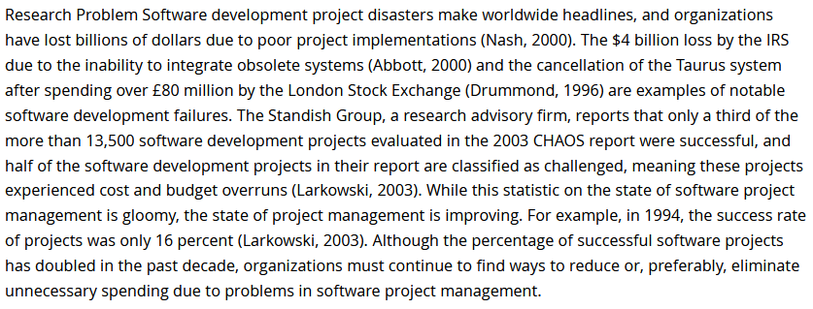
Harvard Referencing in action

Slide 6
Harvard Referencing in action
Citations show in the report body where the ideas, data etc has come from

Slide 7
Harvard Referencing in action
Another citation

Slide 8
Harvard Referencing in action
And another citation

Slide 9
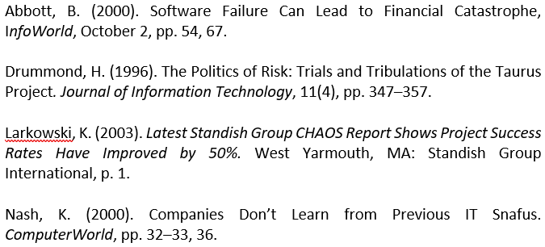
References
Finally list full references in alphabetic order

Slide 10
Academic Integrity breaches
Poor Academic Practice
Cheating - applies to exams, in and outside the room
Plagiarism – ‘The substantial, unacknowledged incorporation into a student’s work of material derived from the work (published or unpublished) of another’ (Leeds Beckett University, 2021, Section 10.3.1)
Self-plagiarism – submitting work for credit which they have submitted elsewhere
Collusion – where collaboration with other students has gone beyond the limits indicated in the assignment
Ghost writing – paying (or not) someone to do some or all of their work
Unfair practice – attempting to gain an unfair advantage

Slide 11
Why does it matter?
Academic Integrity
Credit for what YOU have done, your real attainment
Pride in your work
Issues in your career, where learning has not taken place
University reputation
Detrimental consequences to students’ experience

Slide 12
How do we detect it?
Some assessment methods can minimise opportunities -
Exams, tests, demos, presentations, reflections etc
Range of methods for detection
Lecturers experience –
Changes in writing style, know the students, Knowing the sources, Experience
Grammar analysis
Electronic tool – University Policy to use Turnitin
Matches text in your work with a worldwide database
Highlights sections which have been written elsewhere and gives the source
Does not decide if there is plagiarism, self plagiarism or collusion
Provides a % of the work which has been identified as written elsewhere
All substantial cases investigated

Slide 13
Academic Integrity Breaches - Overview of Local Processes
Category 1 – Poor Academic Practice
Inadequate referencing, Plagiarism, Self-plagiarism
School-level investigation
If found/admitted work will be marked according to the marking criteria
Category 2 – Academic Misdemeanour
Plagiarism, Self-plagiarism, Repeat instances of poor academic practice, cheating
School-level investigation
If found/admitted mark of 0% given for the work
Exam Board will confirm whether the student has a reassessment opportunity

Slide 14
Academic Integrity Breaches - Overview of Local Processes
Category 3 – Academic Misconduct
Repeat instances of academic misdemeanour, Cheating
Institutional process
If found/admitted the module is failed
No reassessment opportunity
Category 4 – Gross Academic Misconduct
Contract cheating, Falsification of data, Cheating
Institutional process
If found/admitted the module student is fail level required to withdraw from the course

Slide 15
What is Substantial?
depends on the piece of work
can mean the actual proportion of the student’s work
what is important or critical to that piece of work e.g.
Aims and Objectives
Conclusion of a report
Image

Slide 16
What is Substantial?
depends on the piece of work
can mean the actual proportion of the student’s work
BUT there is no SAFE limit. You MUST look at the output from Turnitin, and it also depends on Turnitin settings
what is important or critical to that piece of work e.g.
Aims and Objectives
Conclusion of a report
Image

Slide 17
What is Substantial?
depends on the piece of work
can mean the actual proportion of the student’s work
BUT there is no SAFE limit. You MUST look at the output from Turnitin, and it also depends on Turnitin settings
what is important or critical to that piece of work e.g.
Aims and Objectives (Turnitin 10%)
Conclusion of a report (Turnitin 15%)
Image (Turnitin 0%)

Slide 18
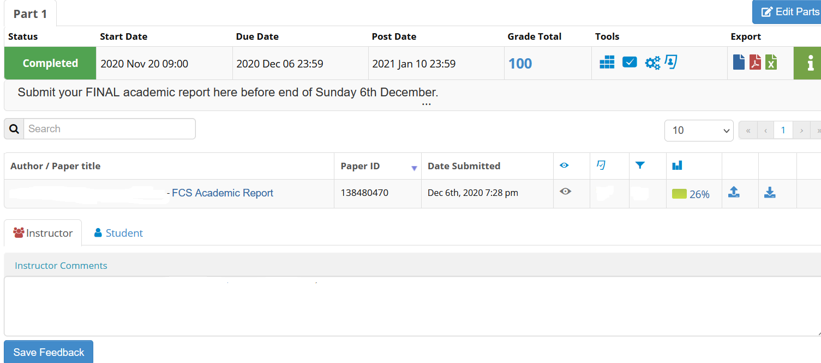
Output from Turnitin
Click on title to see full Similarity report from Turnitin
You can check similarity index but it more important to check the similarity report

Slide 19
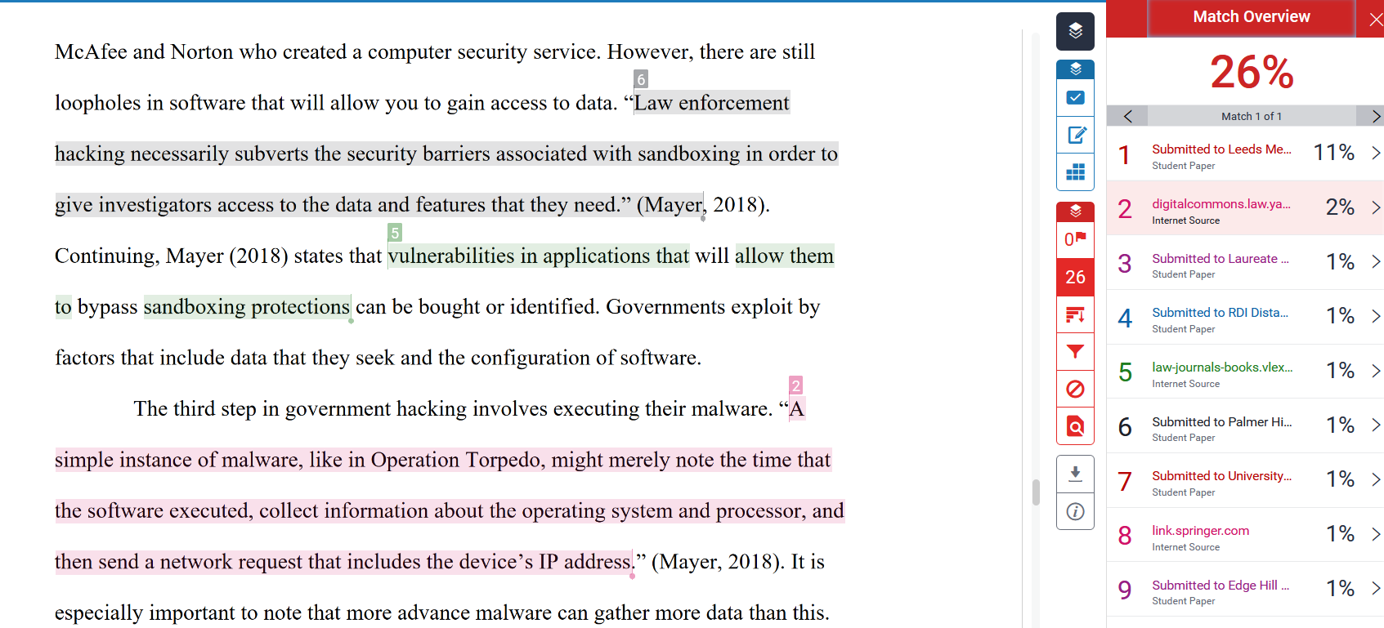
Colour coding indicates matches with sources on right-hand side. Black text is original wording.

Slide 20
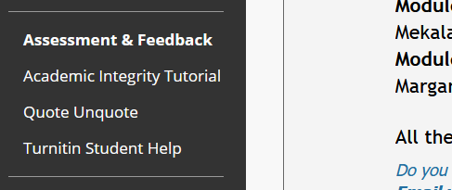
Resources
Academic Integrity Tutorial resource with test in every MyBeckett module
How to avoid plagiarism video www.youtube.com/watch?v=N6jwy5ZFgnI
Report Writing @Skills for Learning
https://libguides.leedsbeckett.ac.uk/skills_for_learning/report_writing

Slide 21
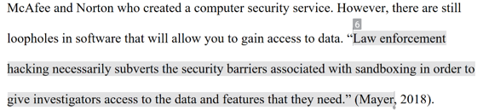
Avoiding Plagiarism - Quotes or Paraphrasing
No more than about 20 quoted words, generally fewer is better
2 or 3 sets of direct quotes is enough in one piece of work
Better to re-write the text in your own words and use a citation
Paraphrasing, summarising, referring to the source
Statistics or data must have the source cited

Slide 22
Referencing
At the end of the report, but before Appendices
Harvard specification of each source used check out A-Z https://libguides.leedsbeckett.ac.uk/subject_support/harvard_referencing/a_z_of_reference_examples
Each type of source has its own type of specification e.g:
Books
e-Books
Websites
Journals
Conference papers
Blogs
Newspapers

Slide 23
Collusion
Discussion of ideas and sources - good
Individual assessments:
Don’t ask to see another student’s work electronically or on paper
Don’t show your work to another student
Keep your work secure
Team based assignments:
Ensure your team collaboration stays within the assignment brief
All team members are responsible for shared submitted documents
Usually, same penalty for all involved

Slide 24
Ghost Writing
Using someone else to write part or all of your assignment
Whether they are paid or not is irrelevant
Category 3/4 harsher penalty including withdrawing students from the university
Often identified by tutors as too good for the level of student:
May be extremely well written e.g. use of language
Uses content outside the scope of the course
Uses resources not available to our students
Doesn’t answer the question set

Slide 25
Be Aware!
What is meant by Academic Integrity?
Why does it matter?
How can it be detected?
What is the process and the penalties?
What other resources are there?

